Slide 1


Networking Basics
Week 6
Types of Addresses in IPv4 Networks
Part 1 of 2
Yvan Perron
CST8103 - Fall 2012

Slide 2
Topics
Address types in an IPv4 network
Calculating the address types
Simple Examples

Slide 3
Network Address Types
Within the address range of every IPv4 network segment with have three address types:
Network address (Aka the Network Id)
Host addresses
Broadcast address

Slide 4
Network Address Types
Network address
The address by which we refer to the network segment (like the area code). All addresses in a network have the same network address bits (same area code within the same region).
Host address
The addresses assigned to hosts in the network segment. Each host has a unique address.
Broadcast address
A special address used to send data to all hosts in the network segment.
Notes:
Network address : is like a are code all the address in a network have the same network address bits. All hosts bits are 0
Host address : segment assigned to hosts in the network segment: Network +1 to Broadcast -1 number of hosts in network : 2^h-2
Broadcast address: special address used to send data to all hosts in network segment. All host bits are 1
One in broadcast address represented by 255
Only change the last bits for calculation

Slide 5
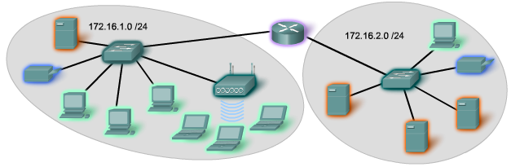
Addressing
Network address: 172.16.1.0/24 (same for everyone)
Host addresses: 172.16.1.1/24 to 172.16.1.254/24 (for each hosts (computer))
Broadcast address: 172.16.1.255/24
Network address: 172.16.2.0/24 (same for everyone)
Host addresses: 172.16.2.1 /24 to 172.16.2.254/24 (
For each hosts )
Broadcast address: 172.16.2.255/24

Slide 6
Calculations
Network address
All host bits are 0s
Broadcast address
All host bits are 1s
Host addresses
Network +1 to Broadcast -1
Number of hosts in network = 2^h-2
Where h equals the number of host bits
Remember: Network bits are constant for all addresses of the same network

Slide 7
Calculations
Perform calculations for 192.168.15.100/24
Network address (all host bits are 0s)
192.168.15.0
Broadcast address (all host bits are 1s)
192.168.15.255
Host addresses
Range → Network +1 to Broadcast -1
192.168.15.1 to 192.168.15.255
Number of hosts in network = 2^h-2
2^8-2=254 host addresses

Slide 8
Calculations
Perform calculations for 172.16.10.254/24
Network address (all host bits are 0s)
Broadcast address (all host bits are 1s)
Host addresses
Range → Network +1 to Broadcast -1
Number of hosts in network = 2^h-2

Slide 9
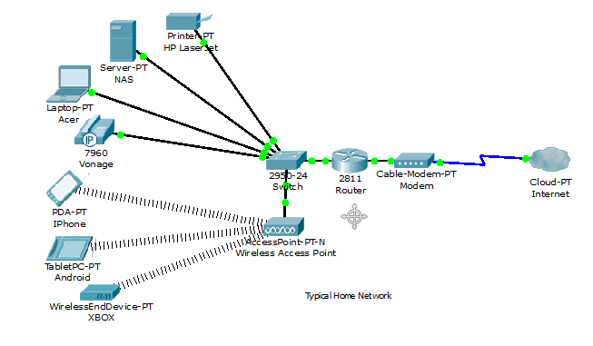
Addressing

Slide 10
Summary
IPv4 Network Addresses
Three types
Network, host and broadcast
Network address all host bits are 0s
Broadcast address all host bits are 1s
Host addresses range between the network and broadcast address
Remember, the network portion is constant across addresses of same network segment

Slide 11
Next
Part 2 of 2 – complex examples

